Slide 1
High Frequency Trading and Mini Flash Crashes
- Anton Golub, John Keane, and Ser-Huang Poon

Slide 2
Overview
Background
Market Structure and Regulations
Dataset
Results and Analysis
Conclusion

Slide 3
Background
Race to Zero
  “Flash Boys” by Michael Lewis
  $300 million Project Express by Hibernia Atlantic
  $250 million Reach Initiative by SGX
2010 Flash Crash
  DJIA dropped by 9%: about 900 points in 5 minutes
  The biggest one-day point decline of 998.5 points
  Flash Crashes raise concerns about the liquidity

Slide 4
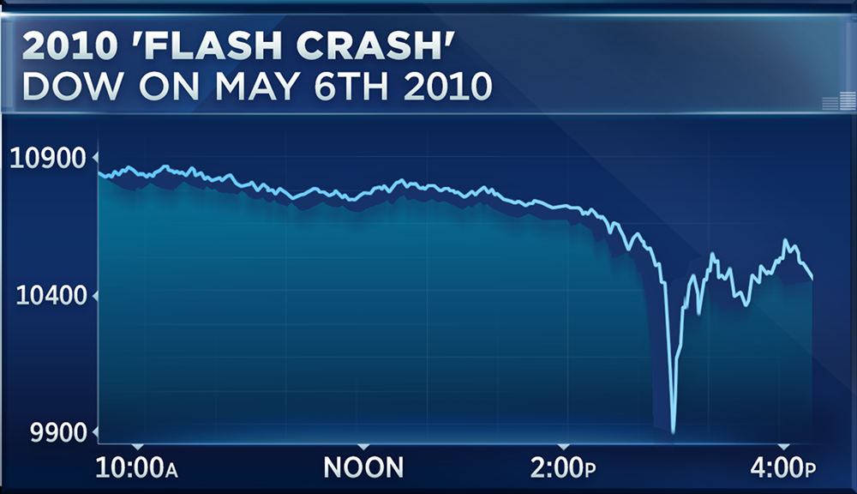
2010 Flash Crash Intraday Chart

Slide 5
Causes of 2010 Flash Crash
SEC
  Caused by a sell algorithm of a large mutual fund executing $4.1 billion worth of E-Mini S&P 500 Futures.
  HFTs didn’t initiate the crash.
Nanex
  Quote stuffing and delays in data feeds combined with negative news from Greece.
  The sell algorithm blamed by SEC did not take liquidity from the market during the Crash.

Slide 6
Mini Flash Crash
Definition
  Down Crash
    it has to tick down at least 10 times before ticking up
    price changes have to occur within 1.5 seconds
    price change has to exceed -0.8%.
  Up Crash (vice versa)

Slide 7
Mini Flash Crash Cases
BATS IPO
  Stock price dropped from $15.25 to $0.0002 as a series of intermarket sweep orders (ISOs) were executed on NASDAQ.
Goldman Sachs
  1.6% price drop in less than 400 milliseconds.
  The crash consisted of 58 trades, where the last 57 were marked ISO

Slide 8
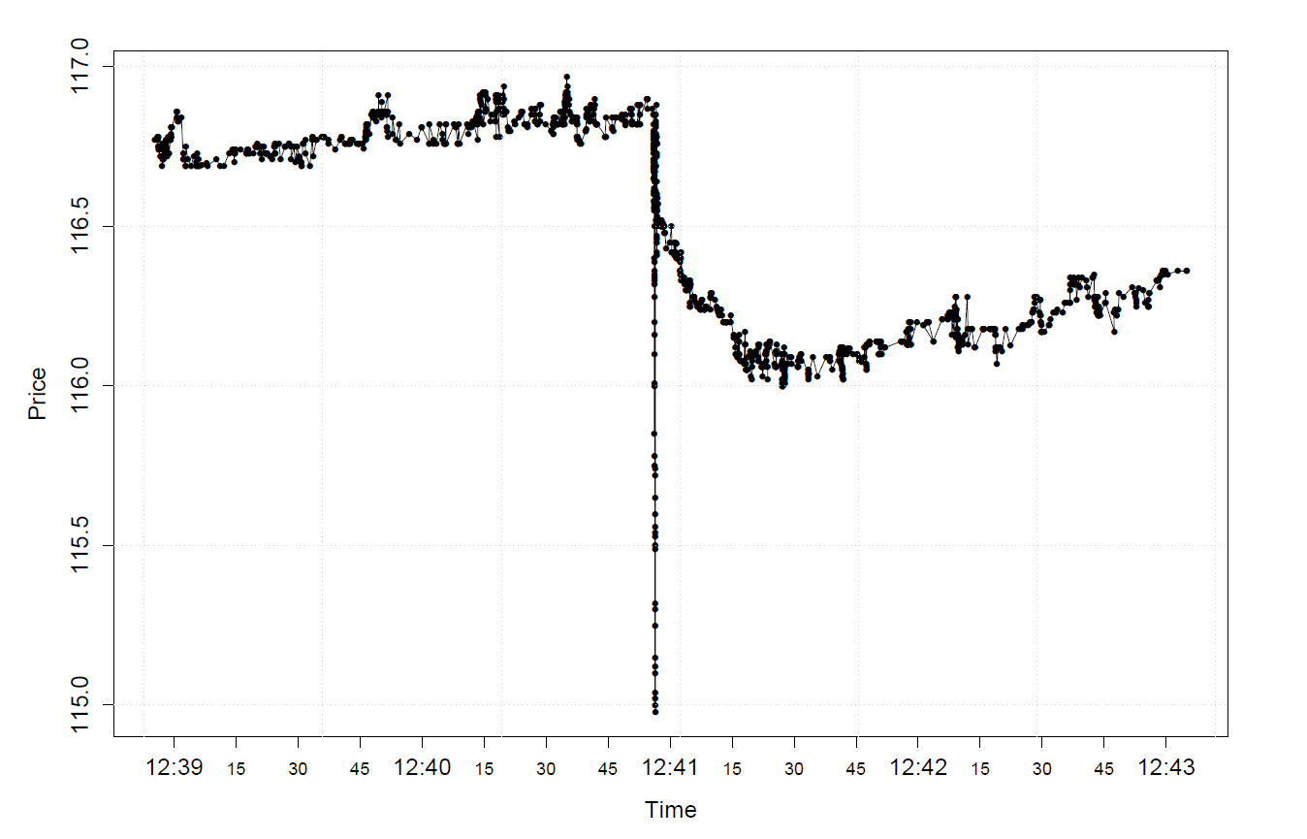
GS Mini Flash Crash Chart

Slide 9
Market Structure and Regulations
Market Structure
  Market fragmentation and trading centers
  13 major stock exchanges, over 30 dark pools, and over 300 internalizing broker-dealers
  The Top of the Book (Best bid and offer)
  Securities Information Processor (SIP) and National Best Bid and Offer(NBBO)
Regulation NMS
  Order Protection Rule
  Intermarket Sweep Order(ISO)

Slide 10
Dataset
Data
  quotes disseminated by Consolidated Quotation System
  Trades disseminated by Consolidated Tape System
  Trades reported from Alternative Trade Facilities
  Information from SIP
Time Frame
  September 2008 to November 2008 and May 2010
  These are the months with the most crashes

Slide 11
Results and Analysis
Two types of Mini Flash Crashes
  ISO initiated
  Auto routing initiated
Occurred on a single exchange
  NYSE, NASDAQ and Arca cover the majority of the crashes
ISOs constitute the majority of the trades

Slide 12
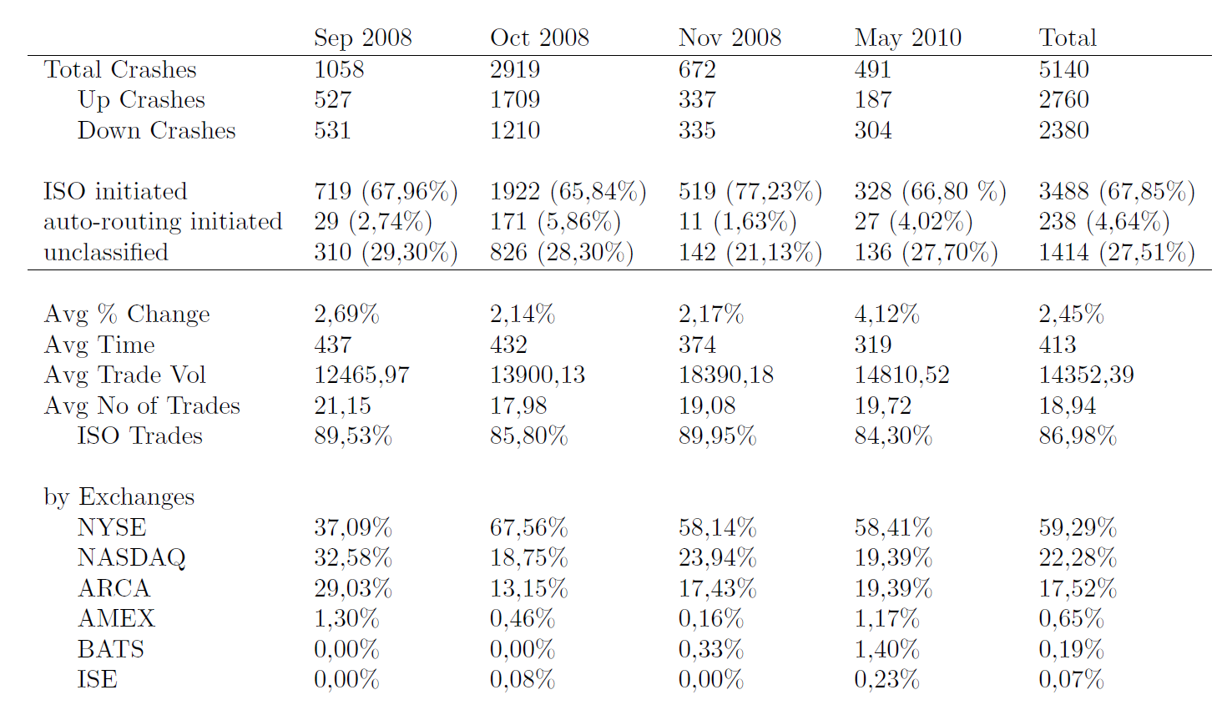
Descriptive Statistics

Slide 13
ISO initiated Crash Mechanism
Submit ISOs to Exchange A and ISOs matching the size of protected quotes to all trading centers quoting at NBBO.

Slide 14
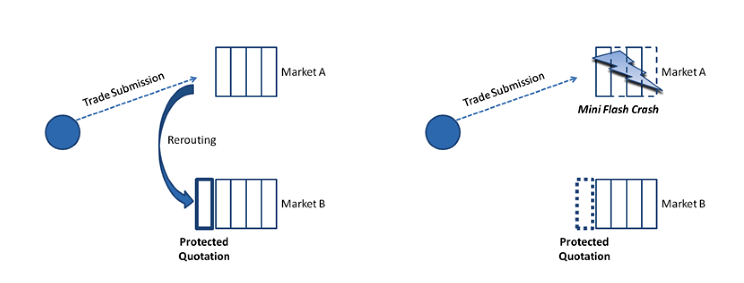
Auto Routing Initiated Crash Mechanism
Submit an order to Exchange A and the part of the order rerouted to Exchange B with protected quotes. Once the protected quotes are cleared at Exchange B, the remaining orders will be filled at Exchange A.

Slide 15
Who is behind the crash?
ISO can only be executed by broker-dealers and traders with sponsored access.
Typical institutional and retail investors do not have access to such trading mechanism.
Given the speed and the magnitude of the crashes, it appears likely that Mini Flash Crashes are caused by HFT activity.

Slide 16
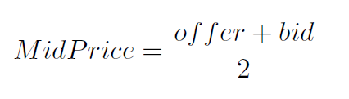
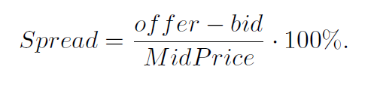
Liquidity Shocks
MidPrice
Spread

Slide 17
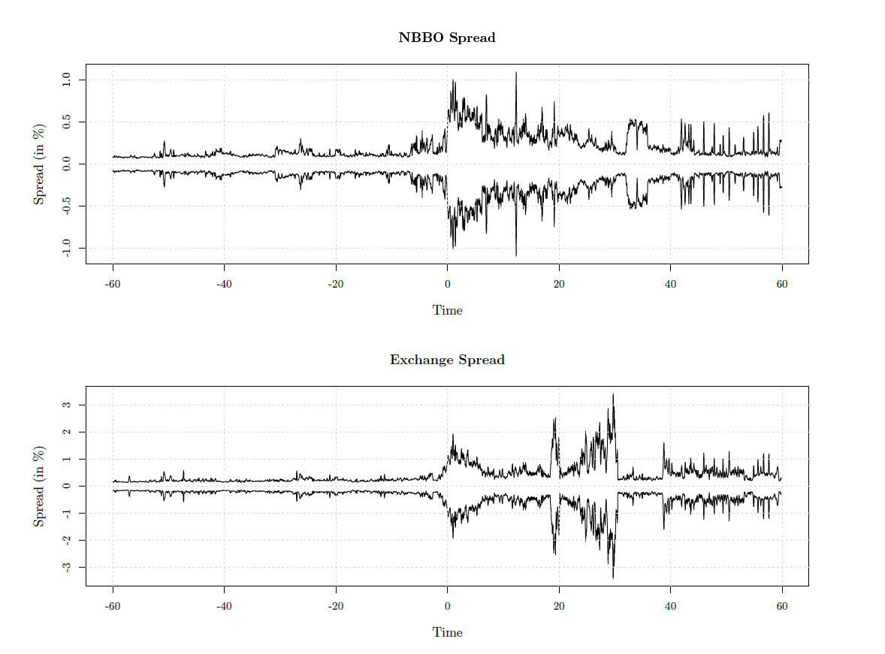
Spread during Mini Flash Crashes

Slide 18
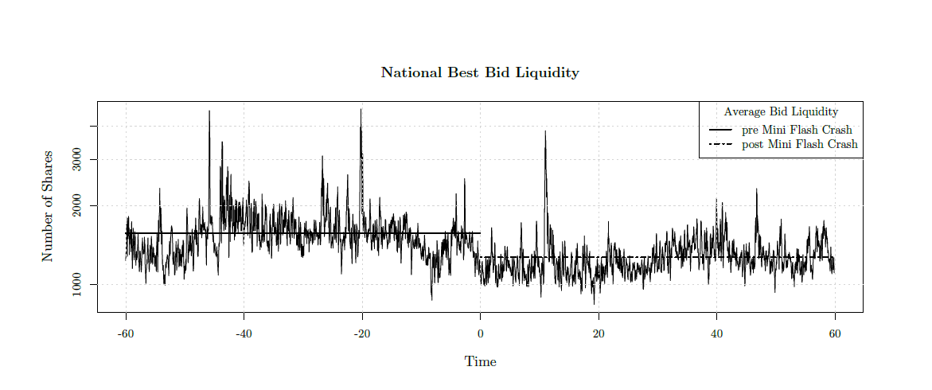
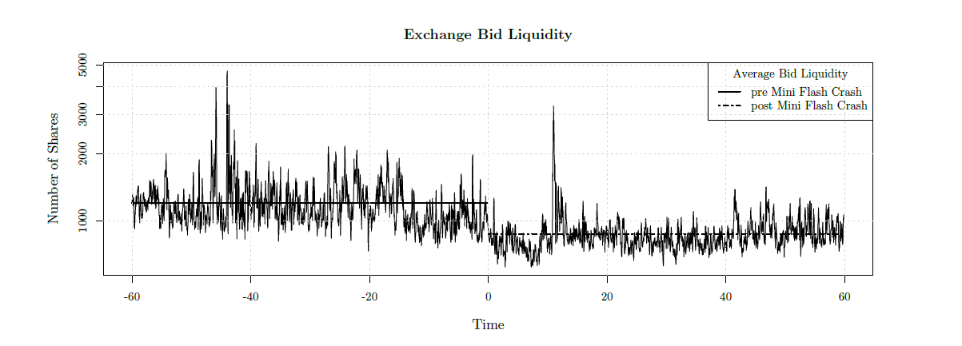
Quote Volume

Slide 19
Conclusion
Regulation NMS
  Order Protection Rule fails to serve its original purpose
  HFT exploited the rules with aggressive use of ISOs
Market fragmentation
  13 public exchanges, more than 30 dark pools and over 200 broker-dealers
  A large number of trading centers makes it difficult to access liquidity in an organized manner

Slide 20
Suggestions
Extend the Order Protection Rule to the Depth of the Book
Ban ISOs

